Slide 1

Nhóm HSTD
Nhập Môn Công Nghệ Phần Mềm

Slide 2

Scrum
01
02
3 Roles
3 Artifacts
03
04
05
4 Events
3 pillars
NỘI DUNG BÀI HỌC
THÀNH VIÊN
THUYẾT TRÌNH

Slide 3

01
THÀNH VIÊN
02
Trần Trí Duy
03
Nguyễn Minh Hoàng
04
Huỳnh Thanh Trọng
05
Lê Thanh Sơn
NỘI DUNG BÀI HỌC
THÀNH VIÊN
THUYẾT TRÌNH

Slide 4

01
Scrum
02
Scrum is a framework for project management that emphasizes teamwork, accountability and iterative progress toward a well-defined goal. The framework begins with a simple premise: Start with what can be seen or known. After that, track the progress and tweak, as necessary.
03
04
05

Slide 5
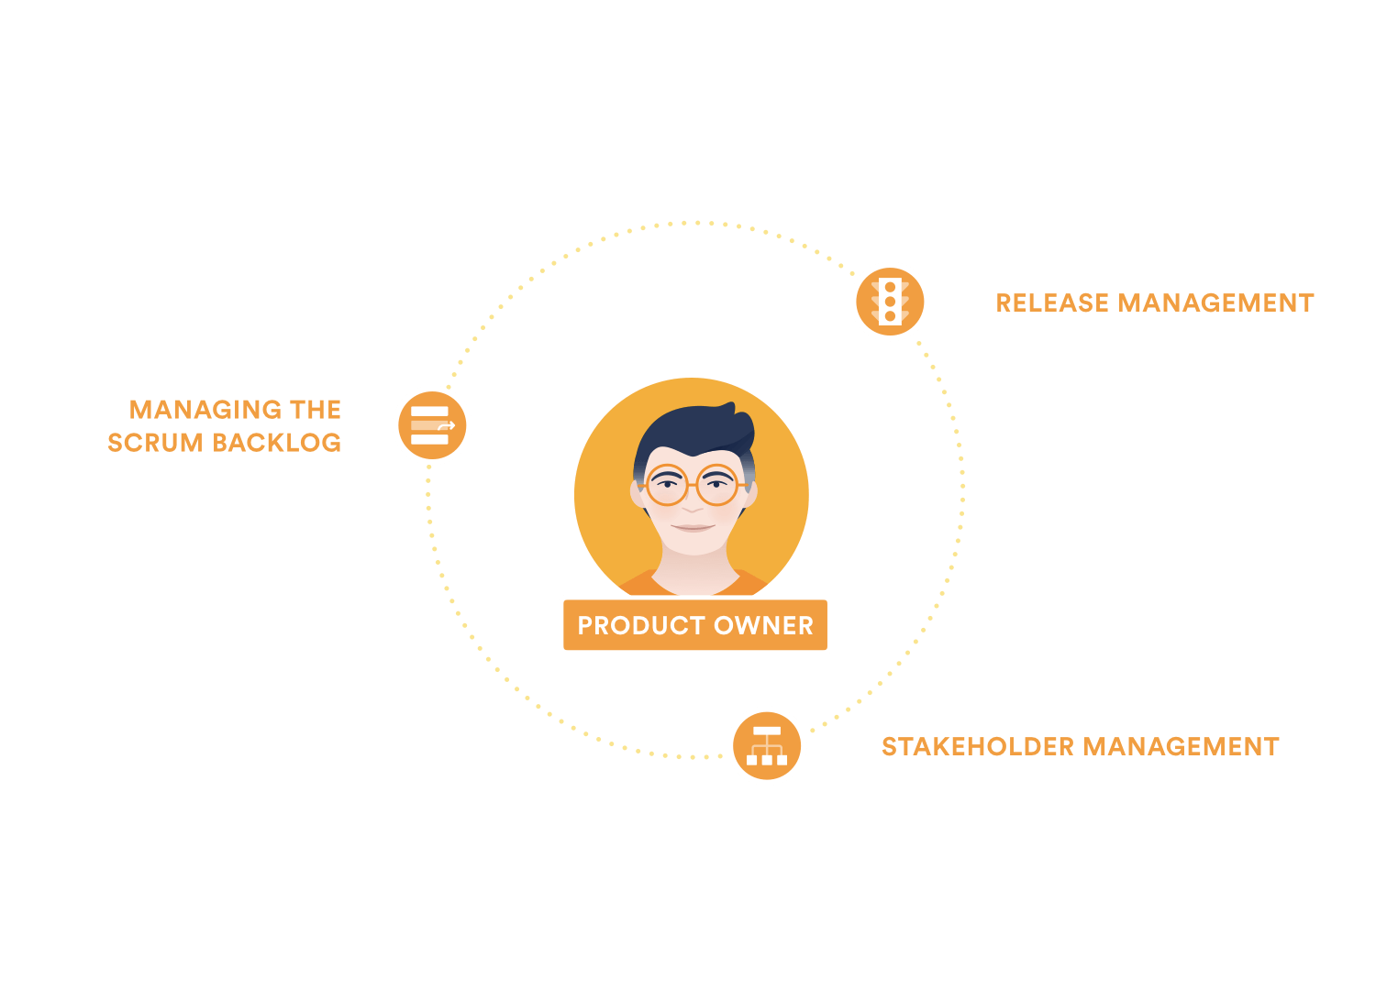
01
1) 3 Roles
02
1. Product Owner
03
- Managing the scrum backlog
- Release management
- Stakeholder management
04
05

Slide 6

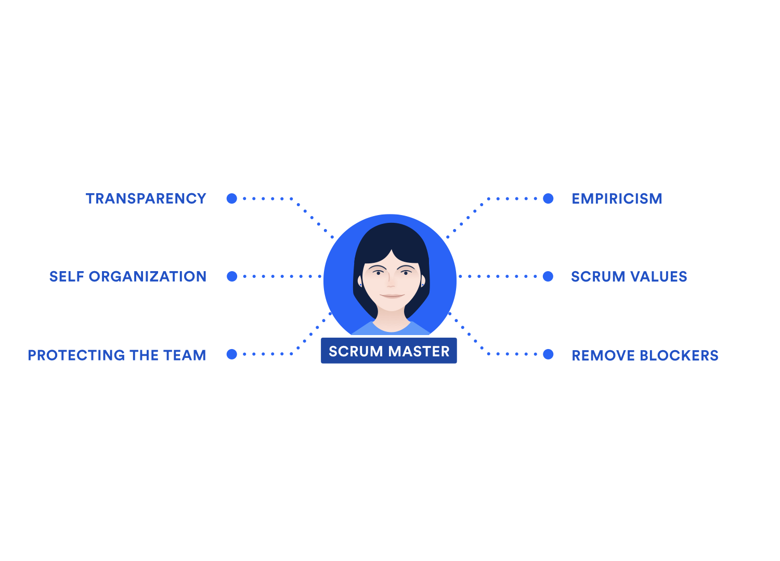



01
2. Scrum Master
02
- Empiricism
- Protecting the team
- Self organization
- Transparency
- Scrum values
- Remove blockers
03
04
05
THANKS FOR WATCHING!
Group Name!

Slide 7
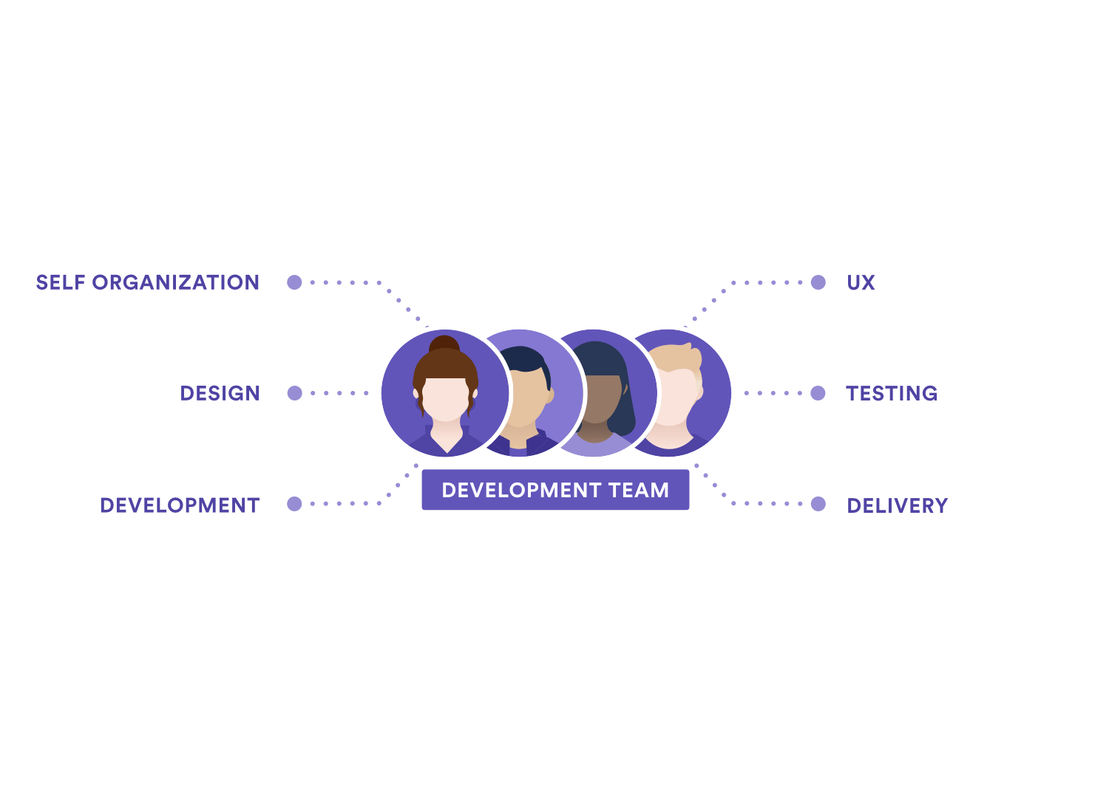
01
3. Development Team
02
- Self organization
- Design
- Development
- User Experience Design
- Testing
- Delivery
03
04
05
THANKS FOR WATCHING!
Group Name!

Slide 8
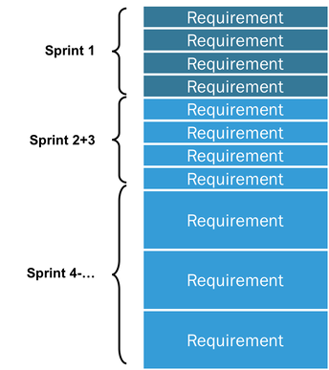

01
2) 3 Artifact
02
1. Product Backlog
03
The Product Backlog is an ordered list of everything that might be needed in the product and is the single source of requirements for any changes to be made to the product.
04
05

Slide 9
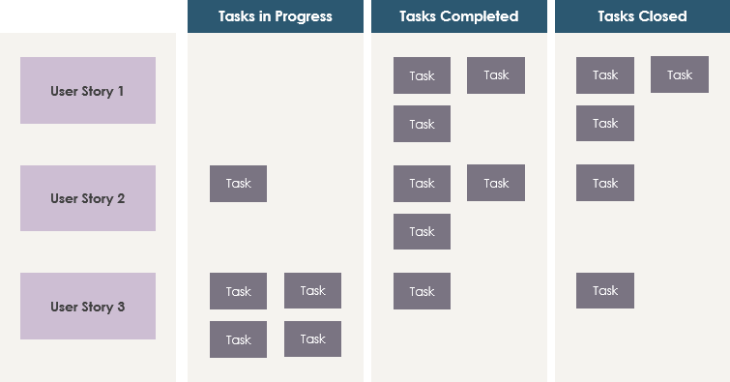
01
2. Sprint Backlog
02
- The Sprint Backlog is the set of Product Backlog items selected for the Sprint plus a plan for delivering the product Increment and realizing the Sprint Goal.
03
04
05
THANKS FOR WATCHING!
Group Name!

Slide 10
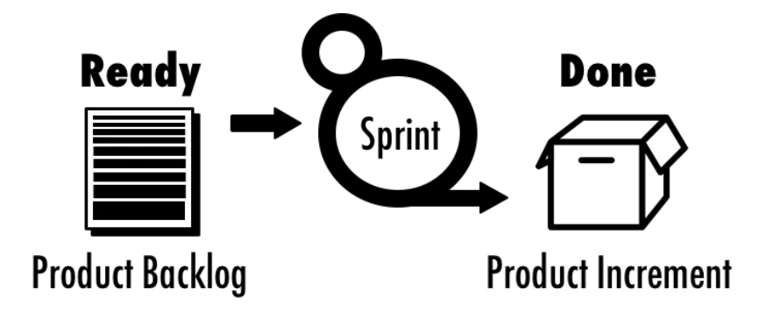
01
3. Increment
02
- The Increment is the sum of all the Product Backlog items completed during a Sprint and all previous Sprints.
03
04
05
THANKS FOR WATCHING!
Group Name!

Slide 11
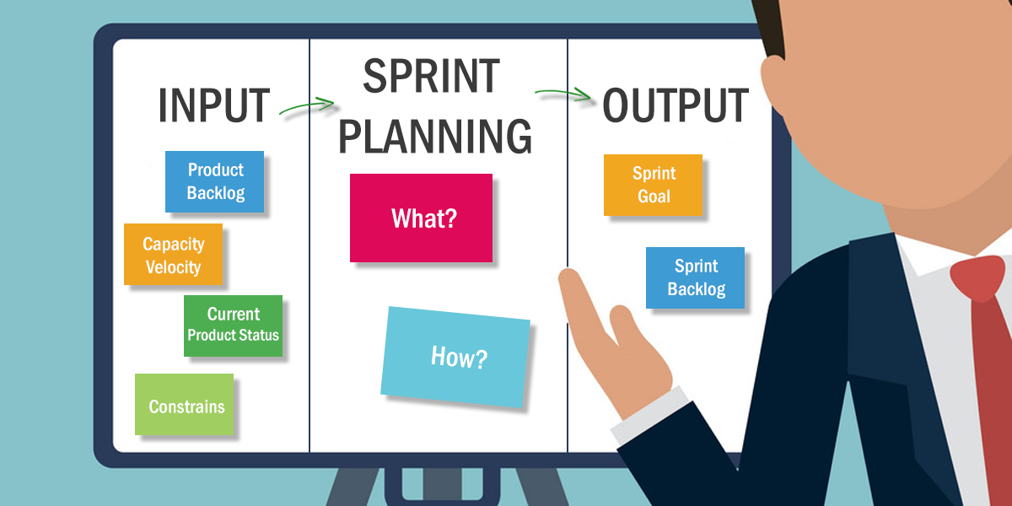
01
3) Events of Scrum
02
1. Sprint Planning (8 hours / sprint or 4 hours / sprint)
- The Sprint begins with a Sprint Planning session to define goals and create a detailed plan of what needs to be done. This Sprint Planning Meeting will answer key questions in turn. Typically with a 1-month Sprint, an 8-hour Sprint planning session and a 2-week sprint, a 4-hour dual Sprint planning session.
03
04
05

Slide 12
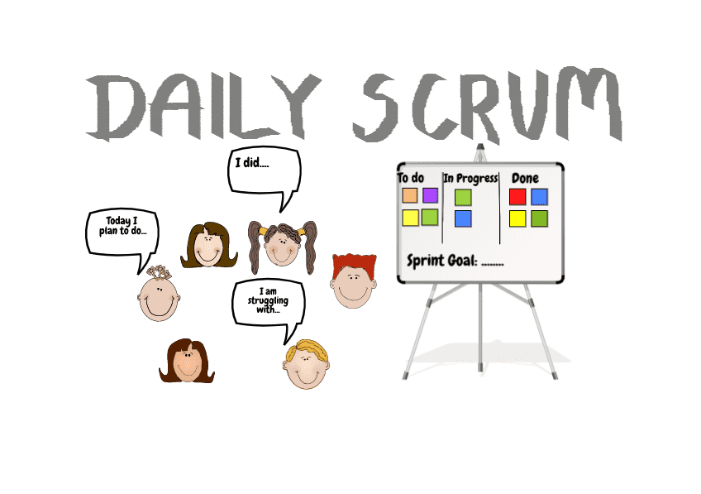
01
2. Daily Scrum (15 mins)
02
Daily Scrum is active lasts for 15 minutes by members of the development team of the Scrum team. To cut down on magazines and make it easy for everyone to do, this activity will take place at the same time, at the same place, every working sprint day.
03
04
05
THANKS FOR WATCHING!
Group Name!

Slide 13
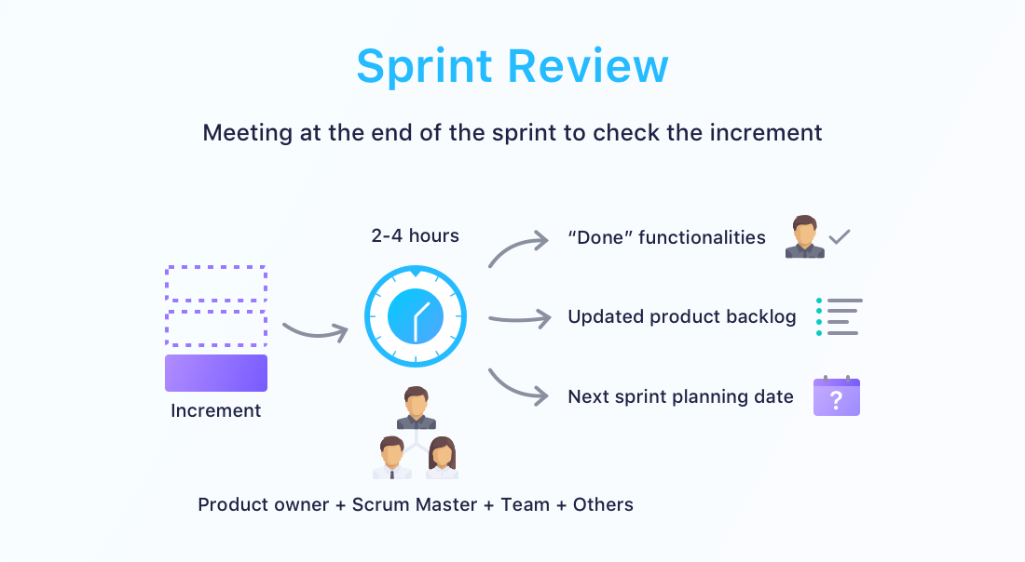
3. Sprint Review (4 hours / sprint)
01
- The Sprint Review is an opportunity for the Scrum Team to get together with stakeholders (Different Department Representatives, CEO, Lead Small Team, etc.) to discuss Growth Accomplishment and update as needed. required for that product. A Sprint Review usually takes place on the last day of the Sprint and allows the Scrum Team the opportunity to show the Done Increment to stakeholders (customers, management and anyone else considered relevant and interested).
02
03
04
05
THANKS FOR WATCHING!
Group Name!

Slide 14
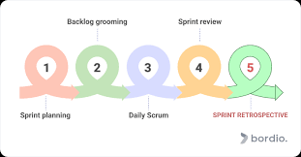
4. Sprint Retrospective (3 hours / sprint)
01
- The sprint retrospective is a recurring meeting dedicated to discussing overall workflow enhancements while recovering at the end of a sprint and preparing to go forward with the next one, so you can make each sprint more streamlined and successful than the last.
02
03
04
05
THANKS FOR WATCHING!
Group Name!

Slide 15

01
4) 3 Pillars
02
Transparency
03
- According to the Scrum Guide, “The emergent process and work must be visible to those performing the work as well as those receiving the work.” It means that every part of the process should be clear as day for everybody on the Scrum Team.
- Transparency allows each team member to track and understand what’s really going on in each sprint—what the plan is, what the progress is, and what the planned input and outcome are.
04
05

Slide 16
01
02
2. Inspection:
03
- “The Scrum artifacts and the progress toward agreed goals must be inspected frequently and diligently to detect potentially undesirable variances or problems,” the Scrum Guide explains.
- Inspection is done by everyone involved in the project, though it should be supported by the Scrum Master, collaborating with the team in all aspects of the process. Together, they diagnose any unplanned deviations from the sprint plan and create opportunities to review them. Every Scrum event should be used for inspection.
04
05
THANKS FOR WATCHING!
Group Name!

Slide 17
01
02
3. Adaptation:
03
- “If any aspects of a process deviate outside acceptable limits or if the resulting product is unacceptable, the process being applied or the materials being produced must be adjusted,” the Scrum Guide notes. Remove what needs to be removed after a thorough inspection and adapt to the new situation and circumstances. Learn from your actions and mistakes.
04
05
THANKS FOR WATCHING!
Group Name!

Slide 18
01
02
03
THANKS FOR WATCHING!
04
05
HSTD

